Slide 1
JSON
JS
Presented By : Asmaa Ahmed

Slide 2
JSON
JSON (JavaScript Object Notation) is a lightweight data interchange format that is easy for humans to read and write and easy for machines to parse and generate. It is widely used in JavaScript and other programming languages as a common format to exchange data between a server and a web application or between different systems.
JSON stands for JavaScript Object Notation
JSON is a lightweight data interchange format
JSON is language independent *
JSON is "self-describing" and easy to understand

Slide 3
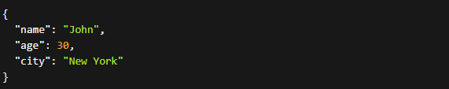
JSON
Structure: JSON represents data as key-value pairs. The data is organized in a simple and hierarchical structure using objects and arrays. Objects are enclosed in curly braces {} and consist of key-value pairs, while arrays are enclosed in square brackets [] and contain comma-separated values.

Slide 4
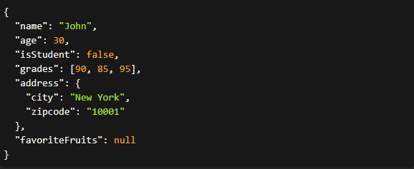
Data Types in JSON
Data Types: JSON supports several data types, including:
Strings: Enclosed in double quotes.
Numbers: Integers or floating-point numbers.
Booleans: Represented as true or false.
Arrays: Ordered lists of values.
Objects: Collection of key-value pairs.
null: Represents an empty value.

Slide 5

Parsing JSON
Parsing json with method parse

Slide 6

Stringify object to JSON
JSON.stringify()

Slide 7
Stringify object to JSON
JSON.stringify()

Slide 8


JSON
Accessing Nested Values:
Handling Arrays in JSON:

Slide 9


JSON
Handling null values in JSON:
Handling JSON with JavaScript Functions:

Slide 10
Thanks!
Do you have any questions?
asmaaahmed23762@gmail.com

